Slide 1


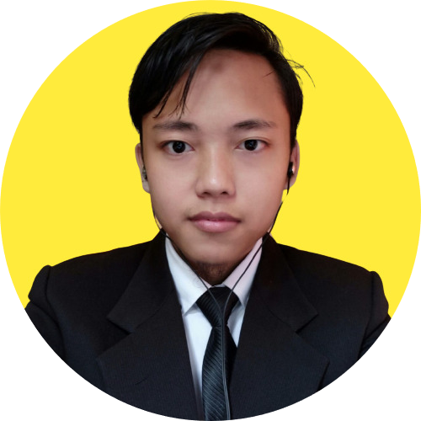
Predict Customer Personality to boost marketing campaign by using Machine Learning
Created by:
Lana Fuadi
lanafuadi@gmail.com
linkedin.com/lanafuadi
“I am a results-driven data scientist with a passion for leveraging data to drive business success. Through rigorous training at Rakamin Bootcamp, I have honed my skills in Python, ML, SQL, and Business Intelligence. I am committed to continuous learning and have completed additional certifications and course to further enhance my expertise. With strong collaboration, critical thinking, and problem solving skills, I am confident in my ability to help your company make data-driven decisions that propel your business to new heights.”

Slide 2
Overview
“Sebuah perusahaan dapat berkembang dengan pesat saat mengetahui perilaku customer personality nya, sehingga dapat memberikan layanan serta manfaat lebih baik kepada customers yang berpotensi menjadi loyal customers. Dengan mengolah data historical marketing campaign guna menaikkan performa dan menyasar customers yang tepat agar dapat bertransaksi di platform perusahaan, dari insight data tersebut fokus kita adalah membuat sebuah model prediksi kluster sehingga memudahkan perusahaan dalam membuat keputusan ”

Slide 3
OBJECTIVE

Slide 4
EXPLORATORY DATA ANALYSIS
Simplilearn

Slide 5
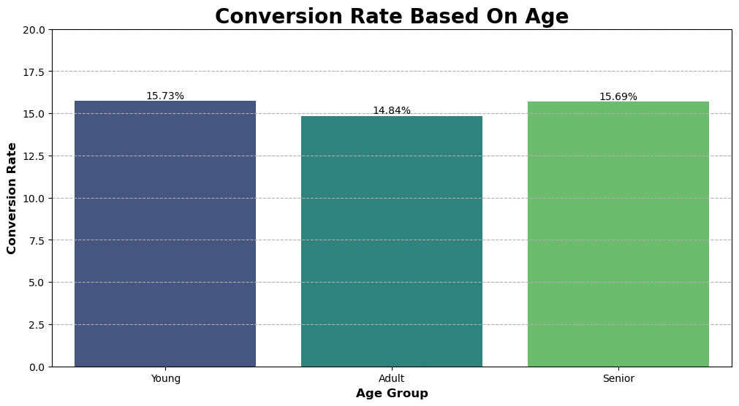
Based on the analysis, all group have relative low conversion rates. it indicates that the existing strategies are not that impactful. this is either because of misaligned marketing or bad website experience. to solve it, we should: 1. improve UI UX design and try to implementing A/B testing to ensure a positive website experience.
2. retargeting strategies to ensure that that is align with customer preference.
3. young is a potential customer, try to add gamification purchase.
For more detail, access jupyter notebook here

Slide 6
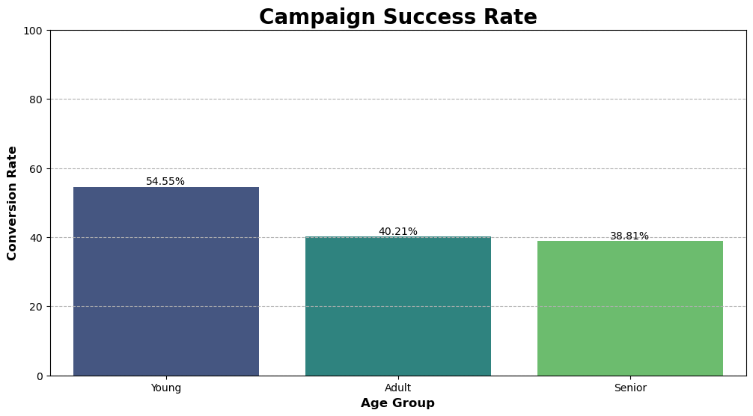
Young group are more likely to make a purchase when receiving a campaign. To maximize campaign success, it is crucial to focus on targeting and tailoring marketing efforts towards young individuals. This could involve creating appealing and engaging campaigns that resonate with their preferences and interests. Both Adult and Senior group has similar rates, it is important to evaluate the existing strategies and identify potential improvement.

Slide 7
ProjectPro

Slide 8
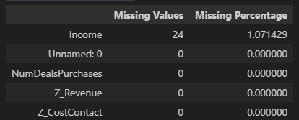
There are 24 missing values in column Income.
It is considerable very few and insignificant since it is only around 1% of data.
To handle it we can drop it or do imputation.
For the sake of assignment, we will do imputation using mean fillna.

Slide 9

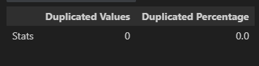
There is no any duplicated value in our dataset.
Then we will not do anything to handle it.
Even after we do mean imputation, we do not find any duplicate.

Slide 10
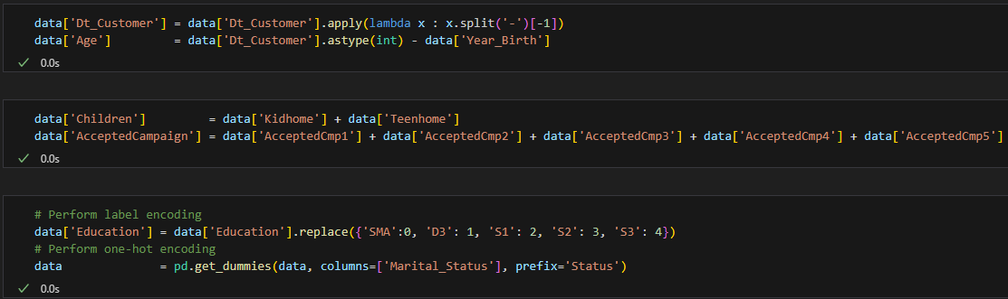
FEATURE ENCODING
We extract new feature from similar features and drop them to reduce dimension.
Age is from Dt_Customer – Year_Birth.
Children is from Teenhome + Kidhome.
AcceptedCampaign is from AcceptedCmp1 + AcceptedCmp2 + AcceptedCmp3 + AcceptedCmp4 + AcceptedCmp5.
We did label encoding on Education because it is considered as ordinal.
We did one-hot encoding on Marital_Status because it is considered as nominal.

Slide 11
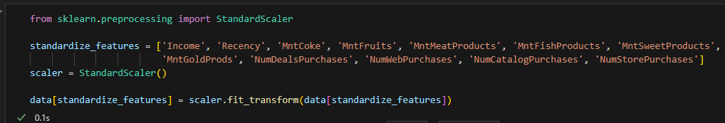
FEATURE STANDARDIZATION
We use StandarScaler to transform numerical features in a dataset to a common scale.
We use it due to its simplicity and effectiveness in many scenarios.

Slide 13

INTERPRETATION
AND
BUSINESS
RECOMMENDATION

Slide 14
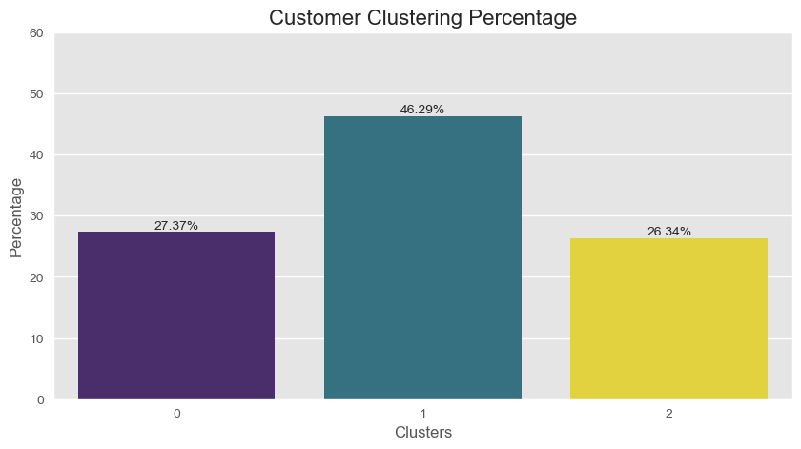
Almost half of our customer are cluster 1 (low customers).
Followed by cluster 0 (medium customers) and cluster 2 (high customers).

Slide 15
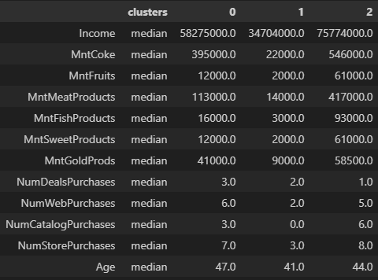
Clusters Insight
1. Cluster 0:
Income 58,275,000/Year
Spend 589,000
Made 7 times store purchases
Made 6 times web purchases
Made 3 times catalog and deals purchases
Age around 47
2. Cluster 1:
Income 34,704,000/Year
Spend 52,000
Made 3 times store purchases
Made 2 times web and deals purchases
Never made catalog purchase
Age around 41
3. Cluster 2:
Income 75,774,000/Year
Spend 1,236,500
Made 8 times store purchases
Made 6 times catalog purchases
Made 5 times web purchases
Only made 1 deals purchase
Age around 44

Slide 16
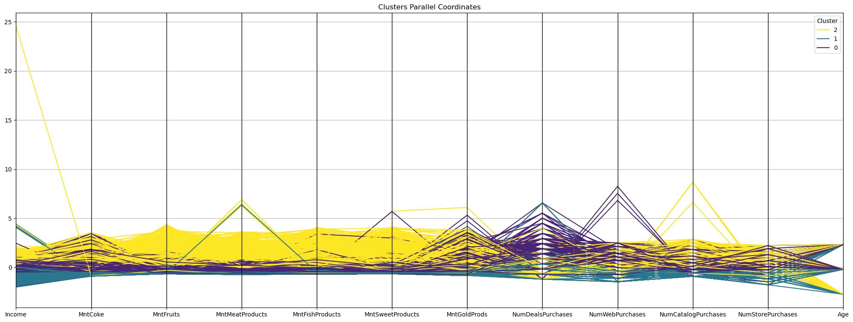
Parallel Coordinates
Cluster 2 has the most spending for various products.
Catalog purchase is more popular in cluster 2.
While deals and web purchase are more popular in cluster 0.
There is no any significant trend among cluster 1.
Age distribution is considerable balance, means has no correlation with clustering behaviour.

Slide 17
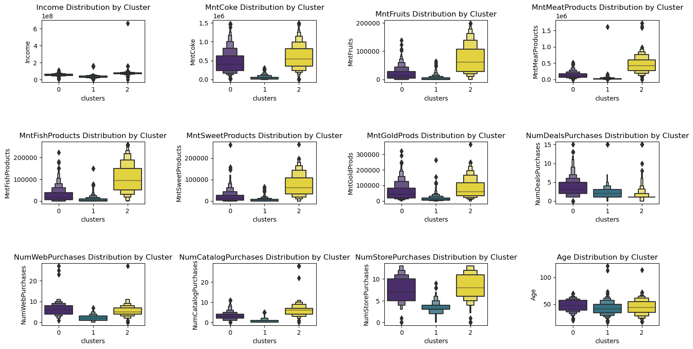
Boxen Plot Distribution

Slide 18
Cluster 0 Recommendation
To further engage customers in Cluster 0, who have medium spending habits, it is important to focus on personalized deals campaigns and specific product categories. We can try these recommendations:
Develop and launch different types of deals, such as limited-time discounts, buy-one-get-one offers, or bundle promotions. Analyze the campaign results to identify the most optimal deals that resonate with this customer segment.
Create personalized deals and targeted marketing campaigns featuring Coke and Gold products. Tailor the offers based on their past purchase history and preferences to increase the likelihood of conversion.
Develop a robust loyalty program that rewards customers for their continued patronage. Offer exclusive discounts, early access to sales, and special promotions to incentivize repeat purchases and foster customer loyalty.

Slide 19
Cluster 1 Recommendation
To address the challenge of low spending habits among customers in Cluster 1, we have to refine the marketing approach and focus on their slight interest in deals. We can try these recommendations:
Focus on digital marketing channels and leverage social media platforms, search engine ads, and targeted email campaigns to showcase products or services that align with their preferences and interests.
Implement Upselling and Cross-selling strategies to increase the average order, provide personalized recommendations during the checkout process or through targeted product suggestions to encourage additional purchases.
Encourage customers to try catalog purchases by offering exclusive incentives, such as limited-time discounts, free shipping, or personalized catalogs tailored to their interests. Highlight the benefits of catalog shopping, such as convenience or a curated selection of products.
Re-evaluate our marketing strategies, analyze customer feedback and conduct surveys to gather insights into their needs, preferences, and pain points.
Capitalize on the slight interest in deals within Cluster 1 by optimizing our deals campaigns. Experiment with different types of deals and offer structures to find the most compelling ones. Monitor customer response and adjust the campaigns based on the data-driven insights gathered during the experimentation phase.

Slide 20
Cluster 2 Recommendation
To leverage the potential of Cluster 2, the highest-spending customer segment, it is important to focus on catalog campaigns and improving in-store services. We can try these recommendations:
Invest in creating visually appealing and engaging catalog campaigns targeted specifically at Cluster 2 customers. Highlight premium products, exclusive collections, and limited editions to capture their attention. Tailor the catalog content to their preferences and use data-driven insights to curate personalized recommendations.
Train our staff to deliver top-notch customer service and create a welcoming and luxurious ambiance in our stores. Consider offering exclusive benefits, such as priority access to new arrivals or dedicated personal shopping assistants, to enhance the overall shopping experience.
Provide personalized VIP treatments, exclusive access to new products, and premium experiences. Offering a dedicated account manager or priority customer support can help nurture loyalty and increase customer satisfaction.
Form strategic partnerships with luxury brands or high-end product suppliers to cater to the preferences of this affluent customer segment. Collaborative promotions or exclusive product collaborations can attract their attention and reinforce the perception of your business as a high-end destination.

Slide 21
More detail is in here

Slide 22


GitHub
Gmail
Linkedin
Let’s Connect !

